Slide 1
Name Infinity
By: Jessie Wilkins and Jordan Throgmorton

Slide 2
Outline
Problem
Solution
Random name generation
-Customization module
-Pre made names
-New names
Demo

Slide 3
Pseudo-randomness Background
Pseudo-randomness has to do with something that is random like
Pseudo-randomness has some bias
Perfectly random comes from 2 independent random like sources
The less predictable, the more random
Source:
- https://www.ias.edu/ideas/2009/wigderson-randomness-pseudorandomness

Slide 4
Problem
The program problem that should be solved is how to choose names without having any preliminary ideas about the name.
This is a common occurrence for the making of a new team or even expecting parents

Slide 5
Design Challenges
The pre made names were limited by the size of list in the file
The new name generation is limited by rules of English words
- Too many rules to implement
Designing rules to make names as close to pronounceable as possible

Slide 6
Business Applications
Expecting parents can use this as a tool to come up with a name for their child
Company start ups would be able to create a name completely unique
Little league sports programs could make unbiased name

Slide 7
Solution
The solution to this problem will involve using Java’s randomization library simply called Random that can randomly select pre-made names and randomly generate a brand new, completely random name.

Slide 8
Similar Applications
https://www.behindthename.com/random/

Slide 9
Random Name Generation
Using Java we were able to use 2 processes for creating random names
The 1st way is with premade names
The 2nd way is with new names
Both ways have their own rules to follow but also have to follow user guidelines

Slide 10
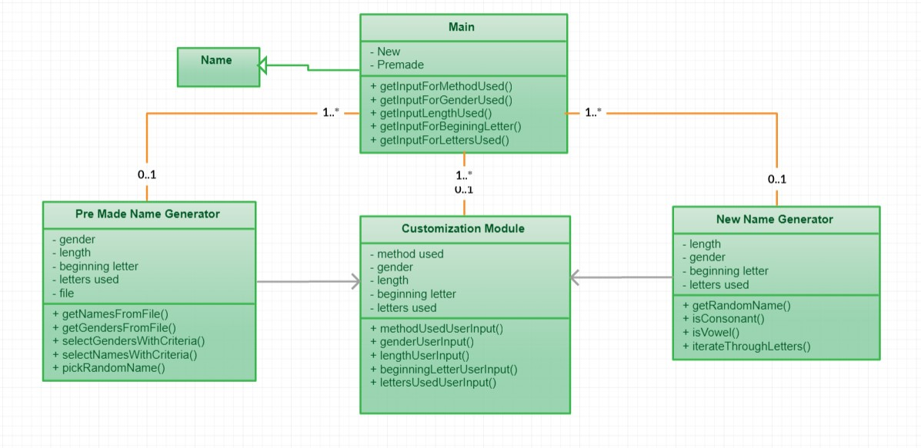
Class Diagram

Slide 11
Customization Module
This allows the user to give guidelines to the name such as
Premade or New names
Gender of name
Beginning letter
Length
Letters used

Slide 12
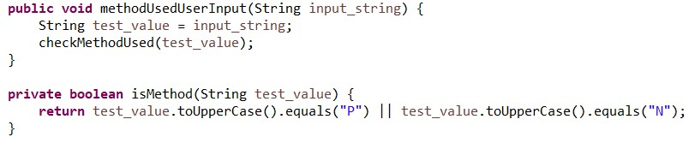
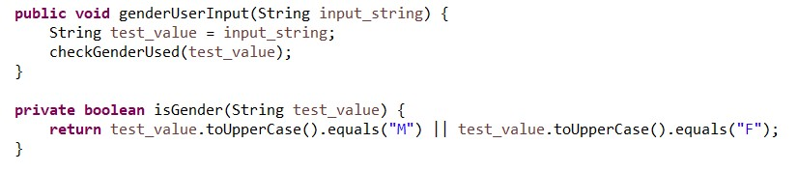

Customization Module Functions

Slide 13
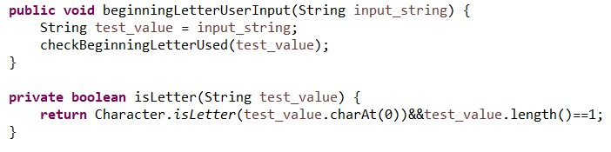

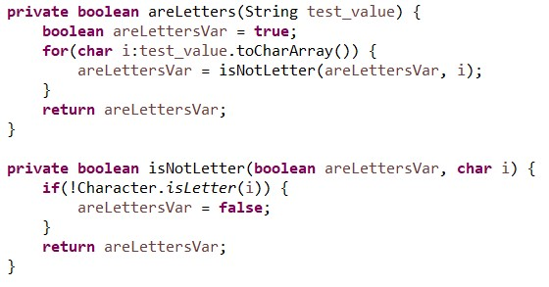
Functions Continued

Slide 14
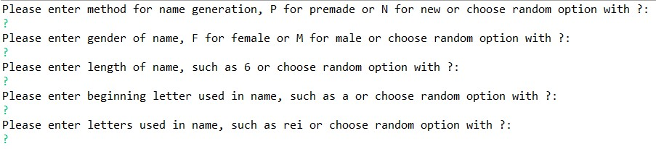
Example

Slide 15
Premade names
Chosen from list of names in a file
Has to follow user criteria when selecting a name

Slide 16
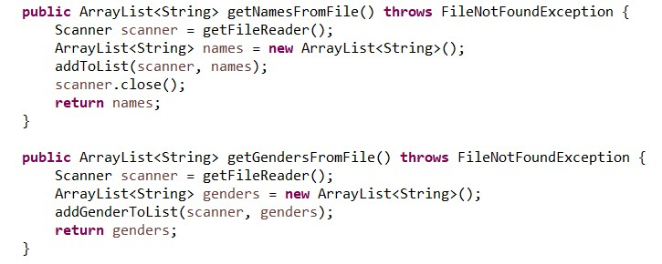
Premade Functions

Slide 17
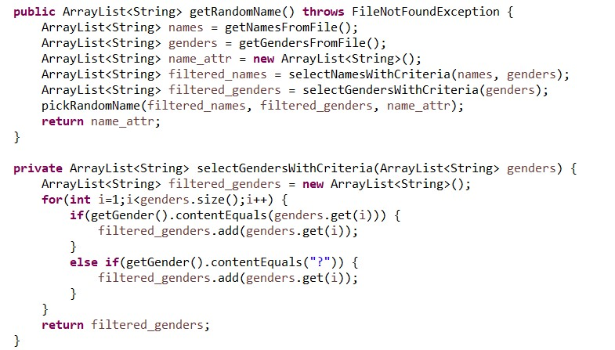

Slide 18
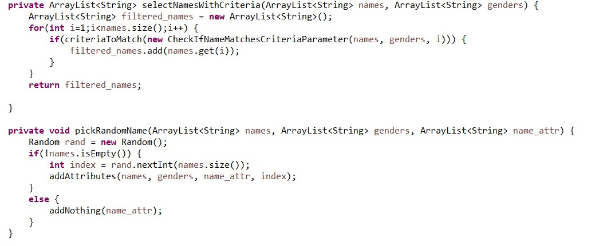

Slide 19
New Names
Created from array of characters
Also follows user criteria for name
Difference:
- name creation has follow special rules

Slide 20
Name rules
No beginning contiguous consonants
No more than 2 contiguous consonants
No more than 2 contiguous vowels
Does not end with 2 contiguous consonants

Slide 21
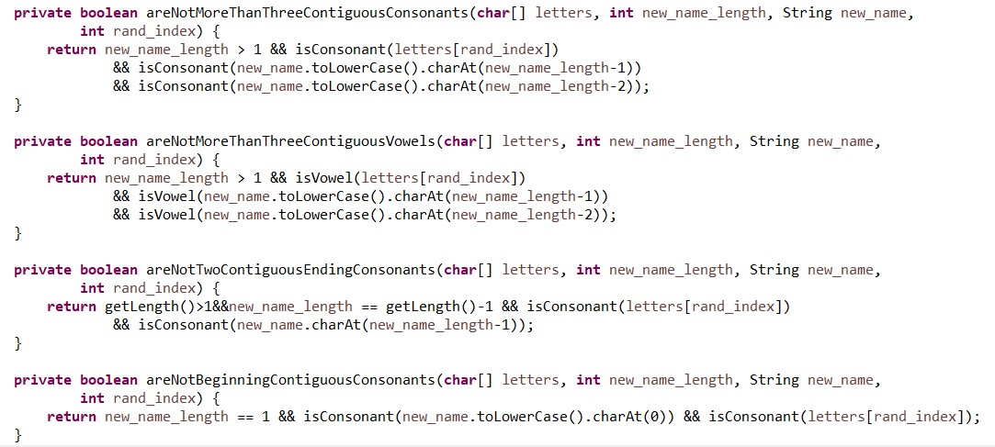
New name Functions

